Slide 1


Olena Tsyganok
04/01/2025

Slide 2
Outline
Executive Summary
Introduction
Methodology
Results
Conclusion
Appendix

Slide 3
Executive Summary
Summary of methodologies
Data Collection API
Data Collection API with Webscraping
Data Wrangling
Exploratory Analysis Using SQL
Data Visualization
Interactive Visual Analytics with Folium
Build an Interactive Dashboard with Ploty Dash
Interactive Visual Analytics and Dashboard
Summary of all results
Exploratory Data Analysis
Interactive Analytics with screenshots
Predictive Analytic results

Slide 4
Introduction
Project background and context
Space X advertises Falcon 9 rocket launches on its website with a cost of 62 million dollars; other providers cost upward of 165 million dollars each, much of the savings is because Space X can reuse the first stage. Therefore if we can determine if the first stage will land, we can determine the cost of a launch. This information can be used if an alternate company wants to bid against space X for a rocket launch.
Problems you want to find answers
What factors determine if the rocket will land successfully
The interaction among various features that determine the success rate of successful landing
What operating conditions need to be fulfilled to ensure a successful landing program

Slide 5

Section 1

Slide 6
Methodology
Executive Summary
Data collection methodology:
SpaceX Rest API
Web scrapping
Perform data wrangling
One-hot encoding was applied to categorical features
Perform exploratory data analysis (EDA) using visualization and SQL
Perform interactive visual analytics using Folium and Plotly Dash
Perform predictive analysis using classification models
How to build, tune, evaluate classification models

Slide 7

Data Collection
Describe how data sets were collected.
Requesting rocket launch data from SpaceX API with the URL
Request and parse the SpaceX launch data using the GET request
Decode the response content as a Json using .json()
Data Wrangling
Dealing with Missing Values
. You need to present your data collection process use key phrases and flowcharts
REST API
Web scrapping
Space X
WIKI
JSON
HTML
Data Frame
REST API

Slide 8
Data Collection – SpaceX API
Request to the SpaceX API
Response content as a Json using.json()and turn it into a Pandas dataframe using .json_normalize()
Do some data wrangling
Clean the requested data
https://github.com/Elygan/DS_LAB/blob/main/jupyter-labs-spacex-data-collection-api-v2_LAB2.ipynb
Request to the SpaceX API
Response content as a Json using.json()
Turn result into a Pandas dataframe using .json_normalize()
Clean the requested data
Filter the dataframe to only include `Falcon 9` launches
Dealing with Missing Values

Slide 9
Data Collection - Scraping
Extract a Falcon 9 launch records HTML table from Wikipedia
Create a `BeautifulSoup` object from the HTML `response`
Parse the table and convert it into a Pandas data frame
https://github.com/Elygan/DS_LAB/blob/main/jupyter-labs-webscrapingLAB.ipynb
Extract a Falcon 9 launch records HTML table from Wikipedia
Create a `BeautifulSoup` object from the HTML `response`
Extract all column/variable names from the HTML table header
Parse the table and convert it into a Pandas data frame

Slide 10
Data Wrangling
Calculate the number of launches on each site and occurrence of each orbit use the method .value_counts()
Calculate the number and occurence of mission outcome of the orbits
Create a landing outcome label from Outcome column
https://github.com/Elygan/DS_LAB/blob/main/labs-jupyter-spacex-Data%20wrangling-v2Lab2.ipynb

Slide 11
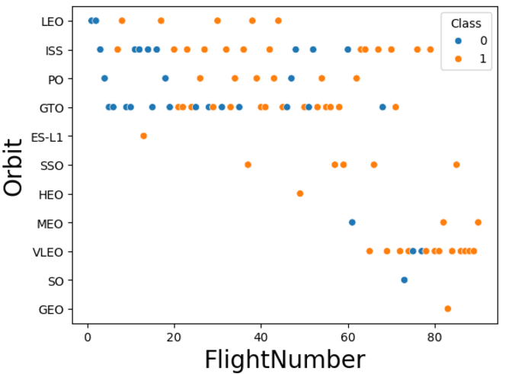
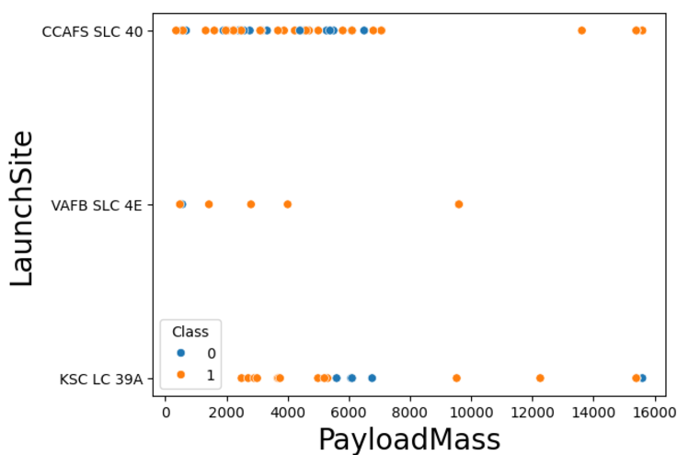
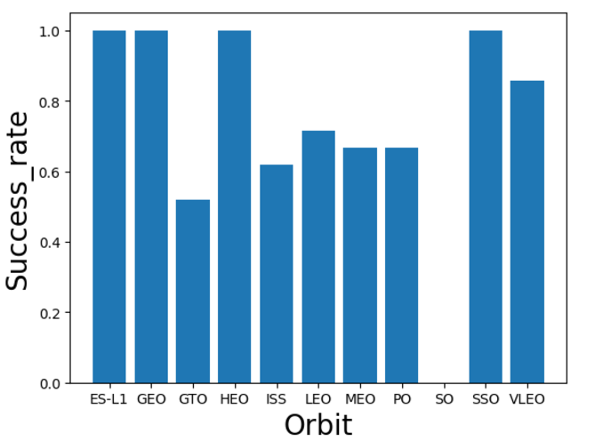
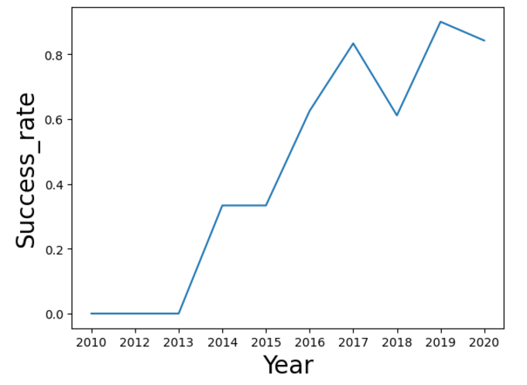
EDA with Data Visualization
Scatterplot | Visualize the relationship between: Flight Number and Launch Site Payload and Launch Site FlightNumber and Orbit type Payload and Orbit type
Bar chart | Visualize the relationship between success rate of each orbit type
Line chart | To get the average launch success trend. https://github.com/Elygan/DS_LAB/blob/main/jupyter-labs-eda-dataviz-v2LAB.ipynb

Slide 12
EDA with SQL
Display the names of the unique launch sites in the space mission
Display 5 records where launch sites begin with the string 'CCA'
Display the total payload mass carried by boosters launched by NASA
Display average payload mass carried by booster version F9 v1.1
List the date when the first succesful landing outcome in ground pad was acheived.
List the names of the boosters which have success in drone ship and have payload mass greater than 4000 but less than 6000
List the total number of successful and failure mission outcomes
List the names of the booster_versions which have carried the maximum payload mass. Use a subquery
List the records which will display the month names, failure landing_outcomes in drone ship ,booster versions, launch_site for the months in year 2015.
Rank the count of landing outcomes (such as Failure (drone ship) or Success (ground pad)) between the date 2010-06-04 and 2017-03-20, in descending order.
https://github.com/Elygan/DS_LAB/blob/main/jupyter-labs-eda-sql-coursera_sqlliteLAB2.ipynb

Slide 13
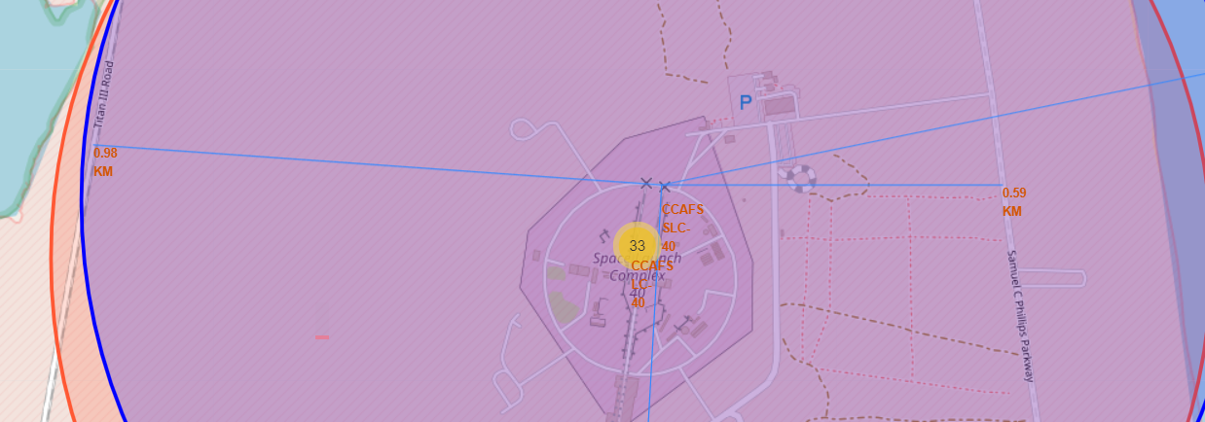
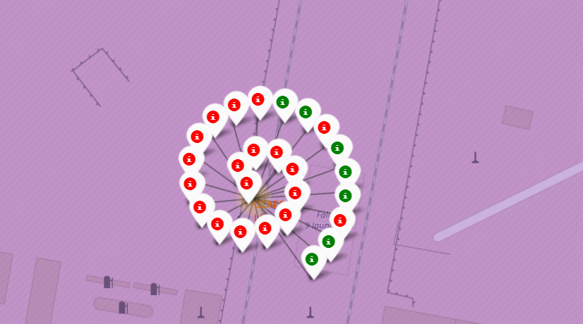
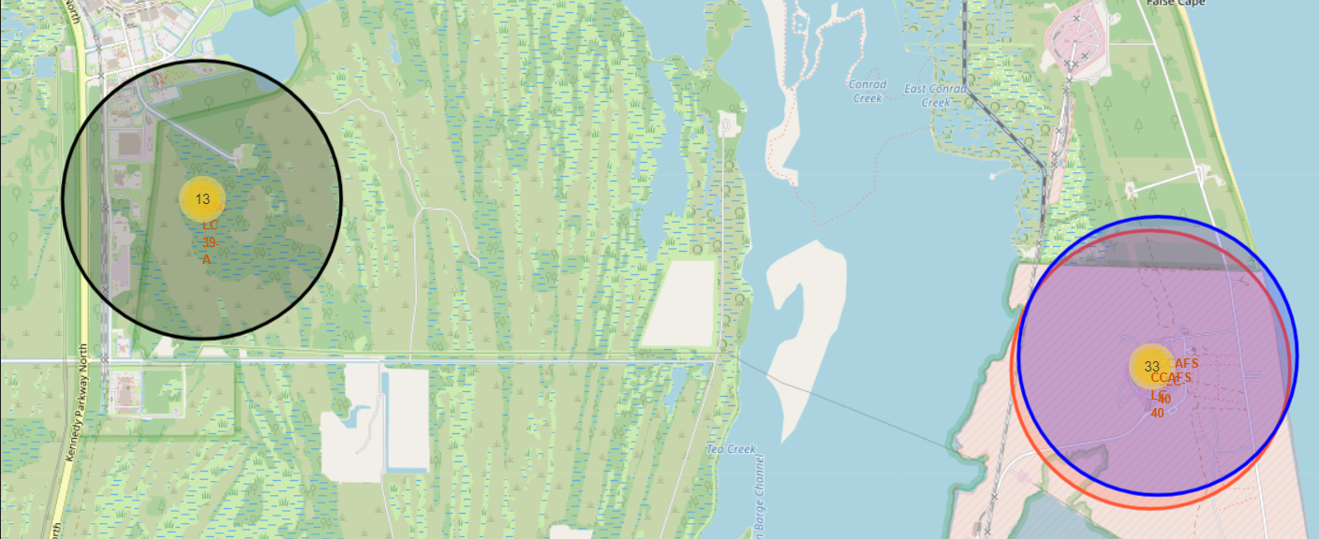
Build an Interactive Map with Folium
We Marked all launch sites on a map
Add a highlighted circle area with a text label on a specific coordinate
Mark the success/failed launches for each site on the map
Create markers for all launch records
Calculate the distances between a launch site to its proximities
Draw a `PolyLine` between a launch site to the selected coastline point
https://github.com/Elygan/DS_LAB/blob/main/lab-jupyter-launch-site-location-v2LAB.ipynb

Slide 14
Build a Dashboard with Plotly Dash
We Build an Interactive Dashboard with Ploty Dash
Add a Launch Site Drop-down Input Component
Add a pie chart to show the total successful launches count for all sites
Add a slider to select payload range
Add a callback function
The general idea of this callback function is to get the selected launch site from site-dropdown and render a pie chart visualizing launch success counts. From a dashboard point of view, we want to be able to easily select different payload range and see if we can identify some visual patterns.
https://github.com/Elygan/DS_LAB/blob/main/UInteractive_Dashboard_with_Ploty_Dash.py

Slide 15
Predictive Analysis (Classification)
Load data frame
Transform data
Split data on training and testing set
Train different classification models
Optimize the Hyperparameter grid search using GridSearchCV object
Evaluate the model
https://github.com/Elygan/DS_LAB/blob/main/SpaceX-Machine-Learning-Prediction-Part-5-v1LAB2.ipynb

Slide 16
Results
Exploratory data analysis results
Interactive analytics demo in screenshots
Predictive analysis results

Slide 17

Section 2

Slide 18
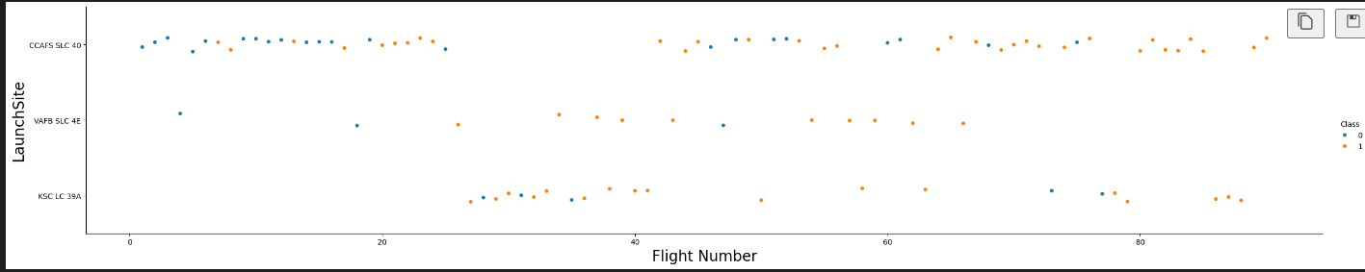
Flight Number vs. Launch Site
The plot shows that the greater the number of flights, the more successful landing on all launch sites

Slide 19
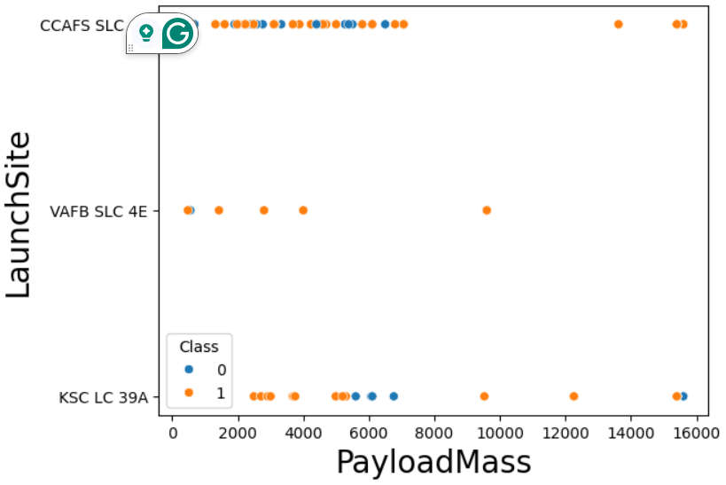
Payload vs. Launch Site
The most common payload mass up to 5800, and it has more successful landing on all launch sites

Slide 20
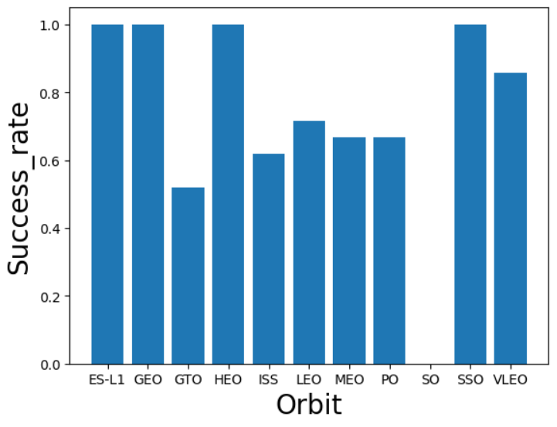
Success Rate vs. Orbit Type
The highest success rate has orbit types: ES-L1, GEO, HEO, SSO and the lowest: GTO, SO

Slide 21
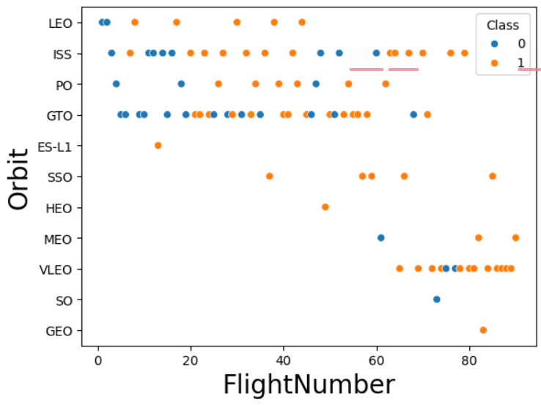
Flight Number vs. Orbit Type
LEO orbit success appears related to the number of flights. But there is no relationship between flight number when in GTO orbit.

Slide 22
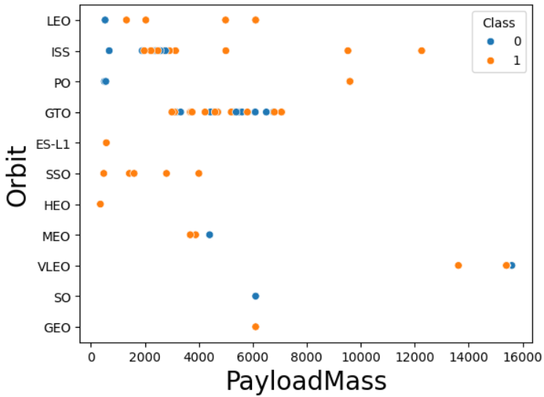
Payload vs. Orbit Type
With heavy payloads the successful landing or positive landing rate are more for Po, LEO and ISS orbits

Slide 23
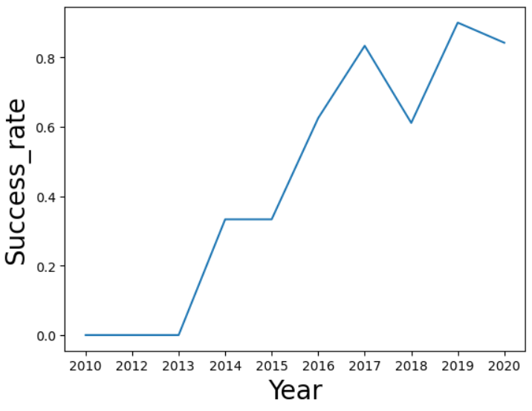
Launch Success Yearly Trend
There is observe a rapid increase success rate from 2013 till 2017, stable in 2014 and decrease in 2017-2018

Slide 24
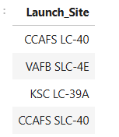
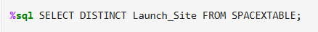
All Launch Site Names
We selected unique Launch sites from SpaceXtable csv file

Slide 25
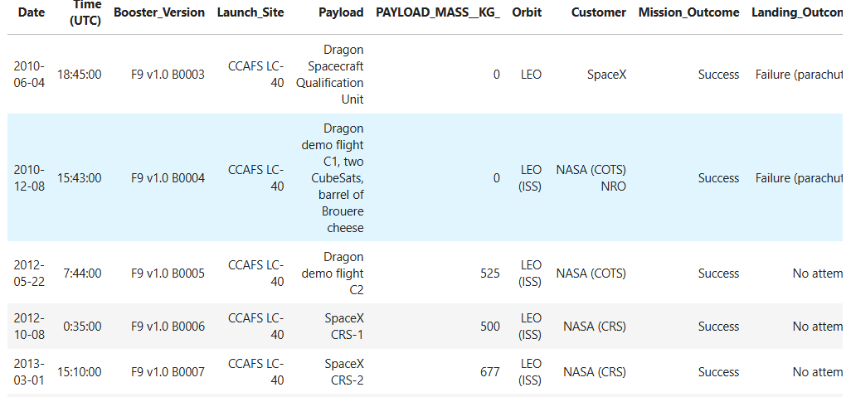
Launch Site Names Begin with 'CCA'
%sql SELECT * FROM SPACEXTABLE WHERE Launch_Site LIKE 'CCA%' LIMIT 5;
We select all records(5 first rows) from SpaceXtable dataset and use ‘CCA%’ to display Launch site wich begin with ‘CCA’

Slide 26
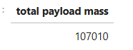

Total Payload Mass
We used sum() function to calculate total payload mass. And used %NASA% to define all words which contain NASA in column “Customer”

Slide 27
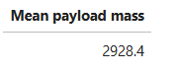

Average Payload Mass by F9 v1.1
We used avg() function to calculate mean payload mass.

Slide 28
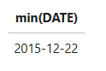

First Successful Ground Landing Date
We use min(DATE) function to determine the oldest date where landing outcome column contain word ‘Success’

Slide 29
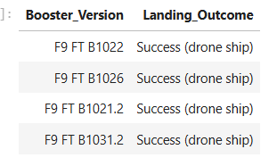
Successful Drone Ship Landing with Payload between 4000 and 6000
%sql SELECT Booster_Version, Landing_Outcome FROM SPACEXTABLE WHERE Landing_Outcome LIKE '%Success%drone ship%’
AND PAYLOAD_MASS__KG_ > 4000 AND PAYLOAD_MASS__KG_ < 6000
We select data in column landing_outcome which contain words ‘Success and drone ship’ and payload mass must be between 4000 and 6000

Slide 30
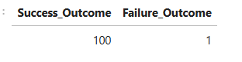
Total Number of Successful and Failure Mission Outcomes
%sql SELECT SUM(CASE WHEN Mission_Outcome LIKE '%Success%'THEN 1 ELSE 0 END) AS Success_Outcome ,
SUM(CASE WHEN Mission_Outcome LIKE '%Failure%'THEN 1 ELSE 0 END)
AS Failure_Outcome FROM SPACEXTABLE
We use function sum() and Mission_Outcome column which contain words ‘Success’ or ‘Failure’

Slide 31
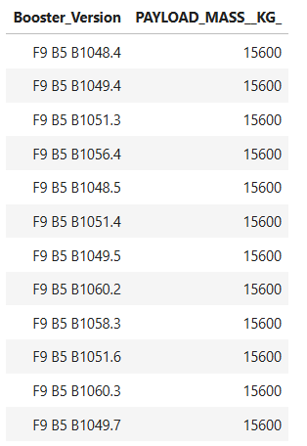
Boosters Carried Maximum Payload
%sql SELECT Booster_Version, PAYLOAD_MASS__KG_ FROM SPACEXTABLE
WHERE PAYLOAD_MASS__KG_ = (SELECT MAX(PAYLOAD_MASS__KG_) FROM SPACEXTABLE )
We use subquery and max() function to determine maximum payload

Slide 32
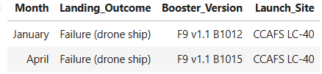
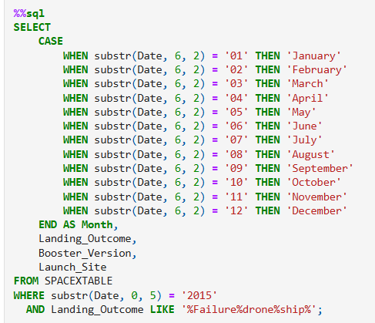
2015 Launch Records
We use substr(Date, 6,2) as month to get the months and substr(Date,0,5)='2015' for year.
And in column Landing_Outcome select records which contain ‘Failure, drone, ship’

Slide 33
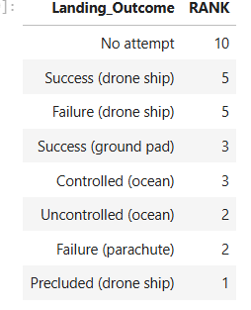
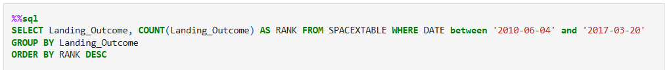
Rank Landing Outcomes Between 2010-06-04 and 2017-03-20
We use function count() to find quantity of landing outcomes and sort in deсsending order

Slide 34

Section 3

Slide 35
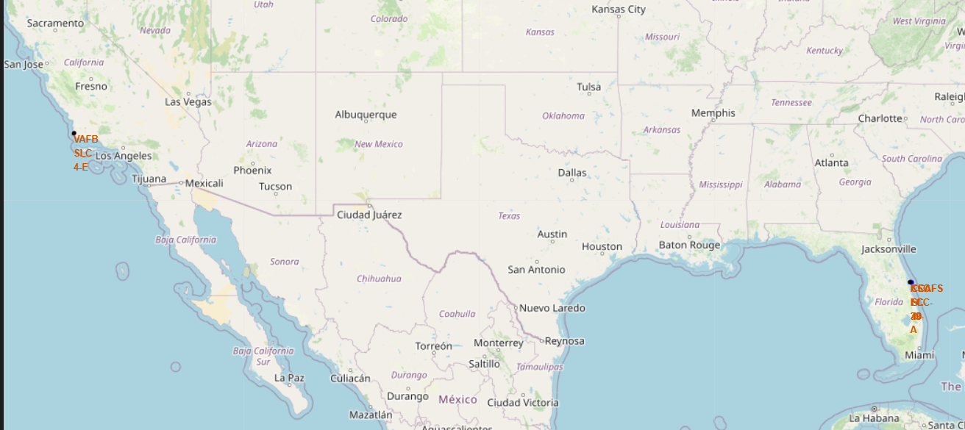
Launch sites
All launch sites in very close to the coast/ Three of them on Cape Canaveral and one near Los Angeles

Slide 36
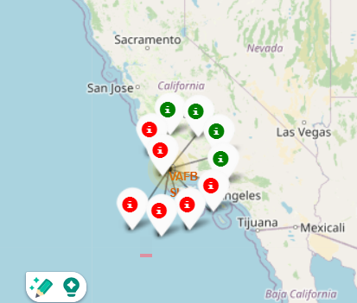
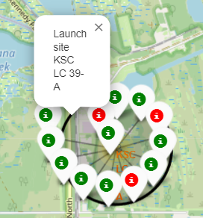
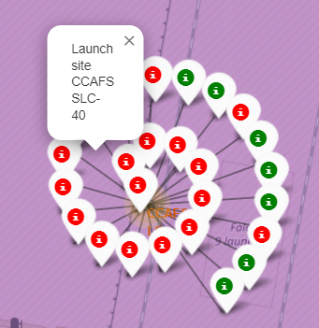
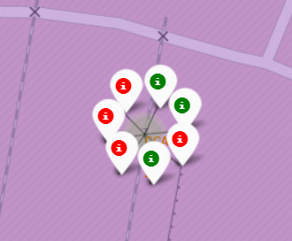
Success/failed launches for each launch site
Green marker color represent success launches, red one failed launches
KSC LC 39-A launch site has the highest success rate
CCAFS SLC-40 launch site has the lowest success rate

Slide 37
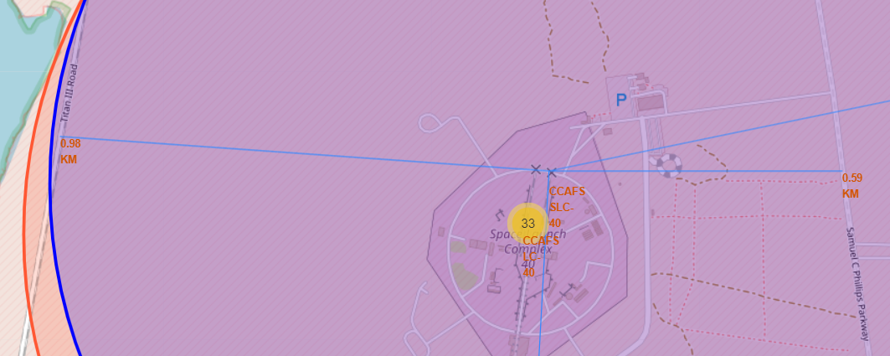
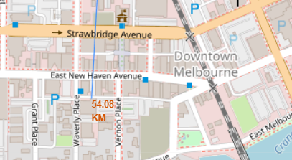
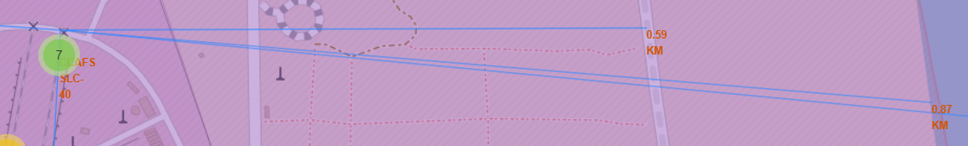
‘PolyLine` and distance between a launch site and the selected point
The distance between CCAFS SLC-40 launch site and:
railways – 0,59km
highway – 0,98 km
Melbourne city – 54,08 km
coastline – 0,87 km

Slide 38

Section 4

Slide 39
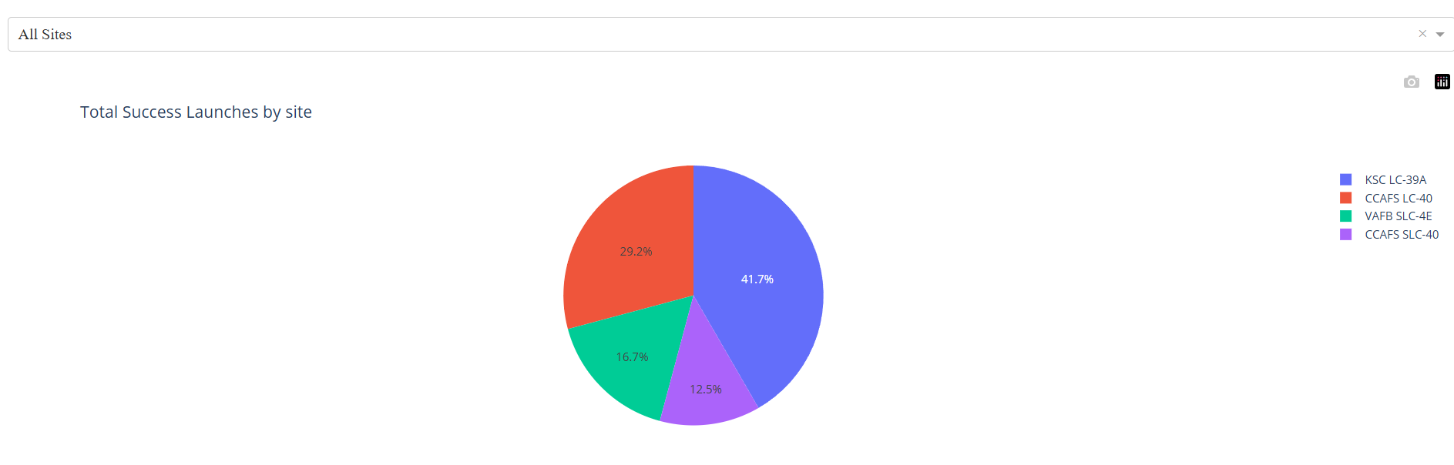
Launch success count for all sites
KSC LC 39-A launch site has the highest success rate
CCAFS SLC-40 launch site has the lowest success rate

Slide 40
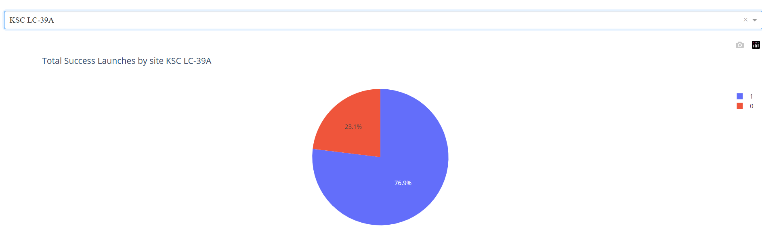
The launch site with highest launch success ratio
KSC LC 39-A launch site has 79,6% success launches and 23,1% failed launches

Slide 41
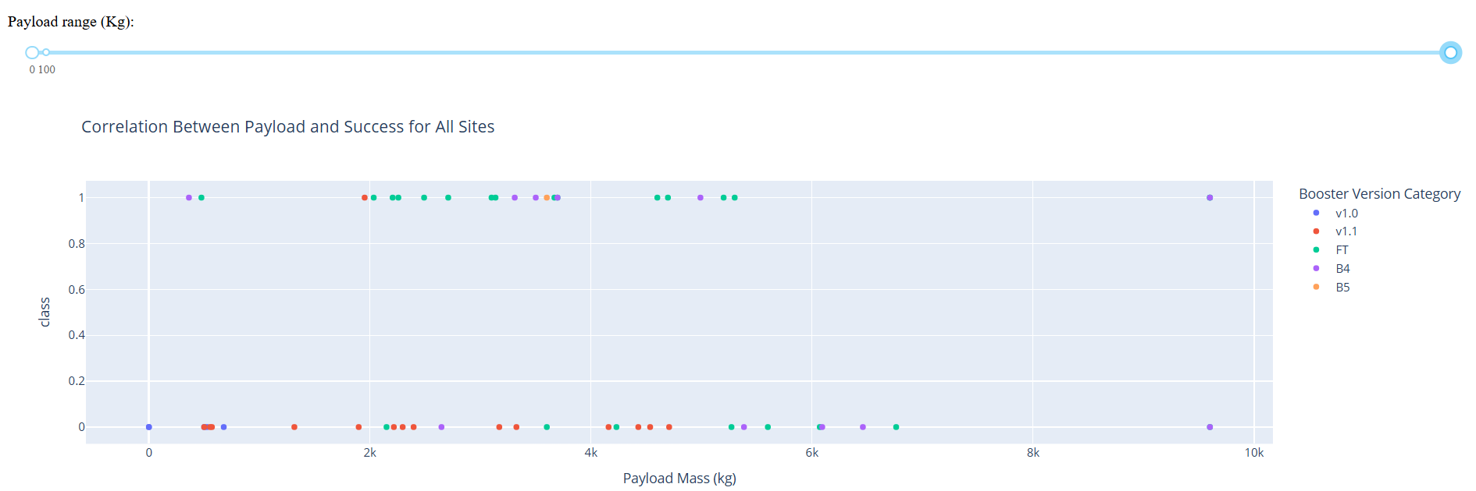
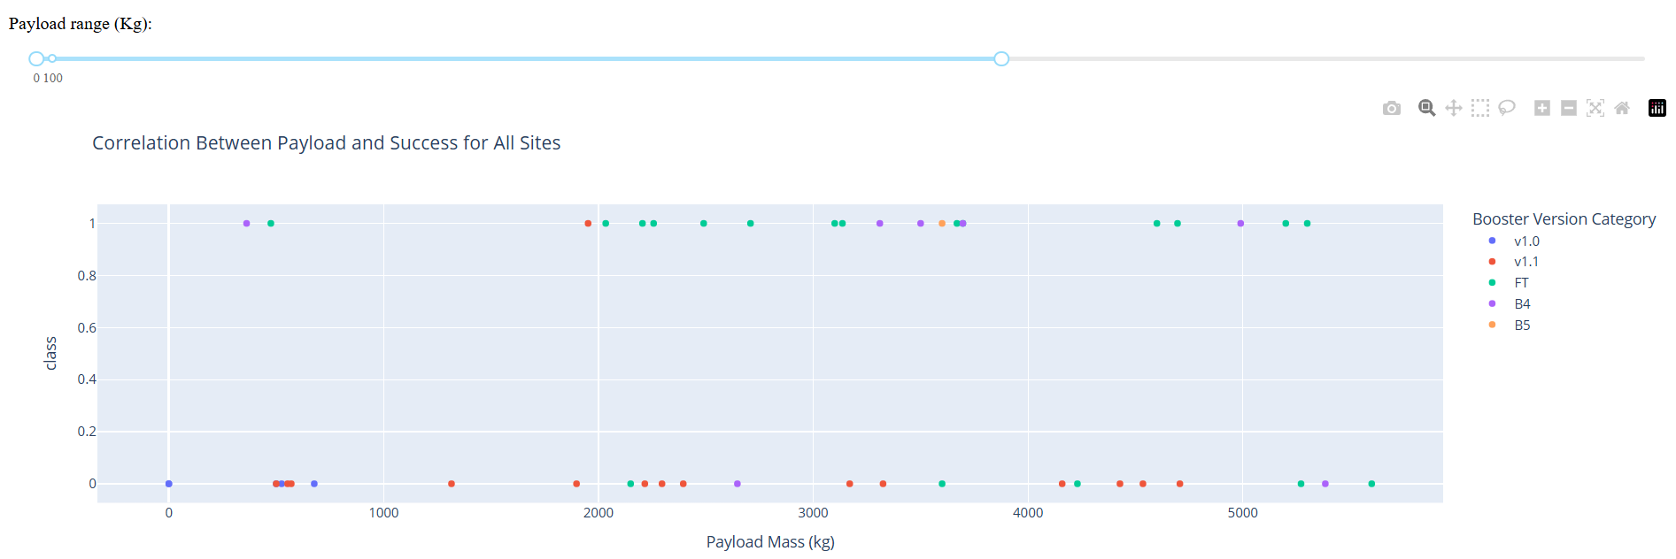
Payload vs. Launch Outcome scatter plot for all sites, with different payload selected in the range slider
The range from 2000kg to 5000kg payload mass has the most successful rate
Booster version FT has more
successful rate

Slide 42

Section 5

Slide 43
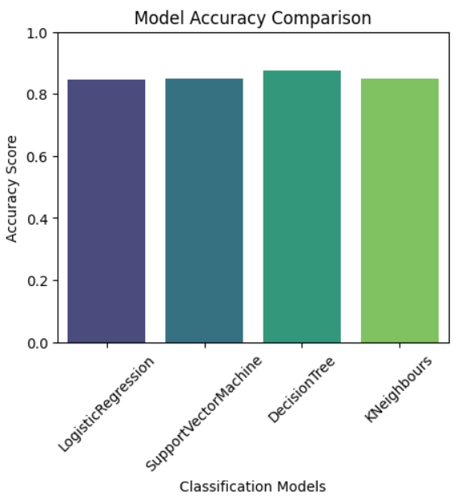
Classification Accuracy
Decision Tree model have the highest accuracy score

Slide 44
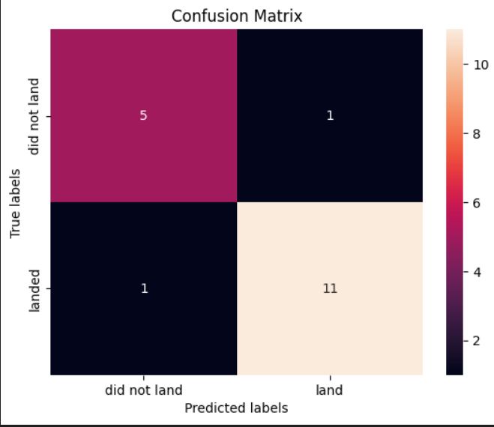
Confusion Matrix
Decision tree classifier model has the highest accuracy 88,8 % compere to other model accuracy 83,3%

Slide 45
Conclusions
The Decision tree classifier is the best model of machine learning for this dataset
KSC LC 39-A launch site has the highest success rate
The highest success rate has orbit types: ES-L1, GEO, HEO, SSO
The greater the number of flights, the more successful the landing at all launch sites
The most common payload mass up to 5800, and it has more successful landing on all launch sites

Slide 46
Appendix
Visual studio code
Jupyter light
labs.cognitiveclass.ai

Slide 47


